Slide 1
Word Sense Disambiguation Tool Using WordNet
DSA0308-Natural Language Processing
Presented By:
Haritha S 192324299
Harisha S 192324300
Umasri N 192424240
Supervisor:
Saravanan.M.S

Slide 2
Abstract
Word Sense Disambiguation (WSD) is an NLP technique used to identify the correct meaning of ambiguous words based on their surrounding context.
English words often have multiple meanings, which creates challenges for computers in understanding and interpreting natural language.
The proposed system uses WordNet, a lexical database, to retrieve possible meanings, definitions, synonyms and sense information of ambiguous words.
The system implements the Lesk algorithm and Naive Bayes classifier to analyze contextual information and identify the most appropriate word meaning.
The system evaluates its performance using sense accuracy, coverage, context window size and comparison with the Most-Frequent-Sense (MFS) baseline.

Slide 3
Introduction
Word Sense Disambiguation is a Natural Language Processing (NLP) technique used to identify the correct meaning of an ambiguous word based on its surrounding context.
Many English words have multiple meanings. For example, the word "bank" can refer to a financial institution or the side of a river. WSD helps determine the intended meaning.
WordNet is a lexical database that groups English words into sets of synonyms called synsets. It provides definitions, relationships, and different senses of words to identify their meanings.
This tool uses techniques such as the Lesk algorithm and Naive Bayes to identify the correct word sense by analyzing context words and comparing them with available meanings.
The system evaluates its performance using sense accuracy, coverage, context window size, and improvement over the Most-Frequent-Sense (MFS) baseline to measure the effectiveness of word sense identification.
Word Sense Disambiguation improves the accuracy of language understanding and is widely applicable in search engines, chatbots, machine translation, text summarization and other NLP applications.

Slide 4
Problem Statement and Objectives
Problem Statement
Words in English often have multiple meanings depending on the context, making it difficult for NLP systems to identify the intended meaning accurately.
Traditional text-processing methods may fail to resolve word ambiguity, affecting the accuracy of language understanding and interpretation.
Objectives
To develop a Word Sense Disambiguation tool using WordNet to identify the correct meaning of ambiguous words based on their surrounding context.
To implement the Lesk algorithm and Naive Bayes classifier for analyzing word senses, lexemes, and contextual information.
To evaluate the system using sense accuracy, coverage, context window size, and improvement over the Most-Frequent-Sense baseline.

Slide 5
Existing System and Proposed Systems
Existing System
Existing systems use traditional NLP and dictionary-based approaches to identify ambiguous word meanings.
They mainly rely on individual techniques such as the Lesk algorithm or machine learning methods, which may have limitations in contextual understanding.
Proposed System
Develop a Word Sense Disambiguation tool using WordNet to identify ambiguous words and retrieve their possible meanings.
Implement the Lesk algorithm and Naive Bayes classifier to determine the correct word sense based on surrounding context.
Evaluate performance using sense accuracy, coverage, context window size, and improvement over the Most-Frequent-Sense baseline.

Slide 6
Modules
Module 1:
WordNet and Ambiguous Word Identification Module: Identifies ambiguous words from input sentences and retrieves their possible meanings, definitions, synonyms, and sense inventory using WordNet.
Module 2:
Word Sense Disambiguation Module: Implements the Lesk algorithm and Naive Bayes classifier to analyze surrounding context and identify the most appropriate meaning of each ambiguous word.
Module 3:
Performance Evaluation Module: Evaluates the system using sense accuracy, coverage, context window size, lexeme and sense analysis, and comparison with the Most-Frequent-Sense baseline.

Slide 7
Thank You

Slide 8
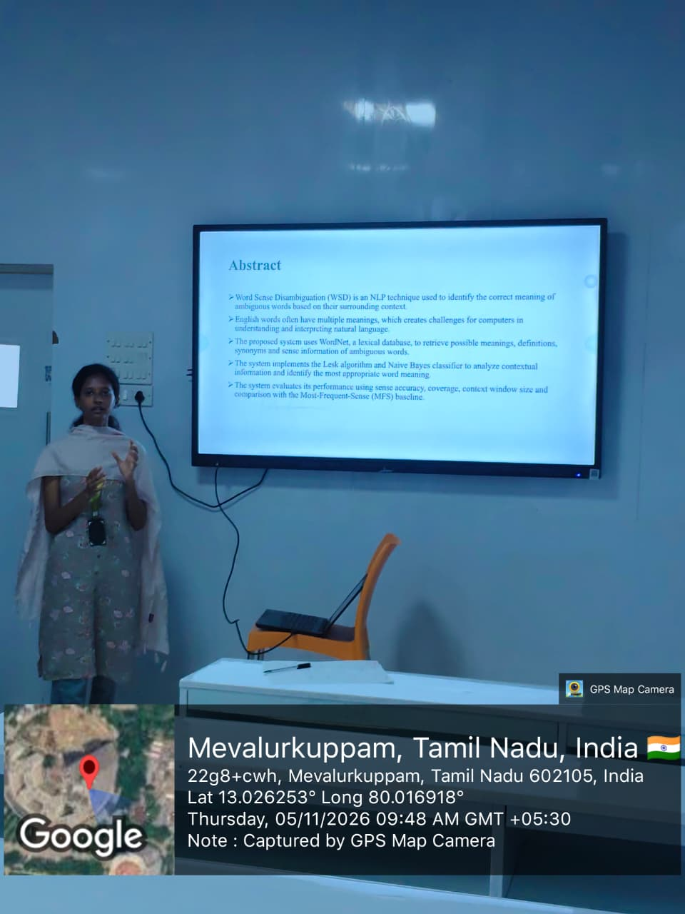
Geotag

